Slide 1
Shakarganj Limited Bhone
1/16

Slide 2
SHAKARGANJ LIMITED (BHONE)
How to Increase the Life of Variable Frequency Drives & Control the Impact of Harmonics
By
Muhammad Anees Abeer
(GM E & I)
Strictly Private and confidential
Shakarganj Limited Bhone
2/16

Slide 3
Introduction
VFDs are necessity of industry. They are used from heavy to small size motors due to its torque load controlling, speed controlling and energy saving properties.
As VFDs are a huge investment and this capital needs to be beneficial for long term. But in some industries VFDs become non operational within a short period of time thus becoming uneconomic for the industry. Unanticipated failure of these equipment can be avoided by using the methods that will be described in this paper.
Irrespective of all these benefits, VFDs also generate harmonics and methods to control the harmonics will also be described.
Strictly Private and confidential
Shakarganj Limited Bhone
3/16

Slide 4
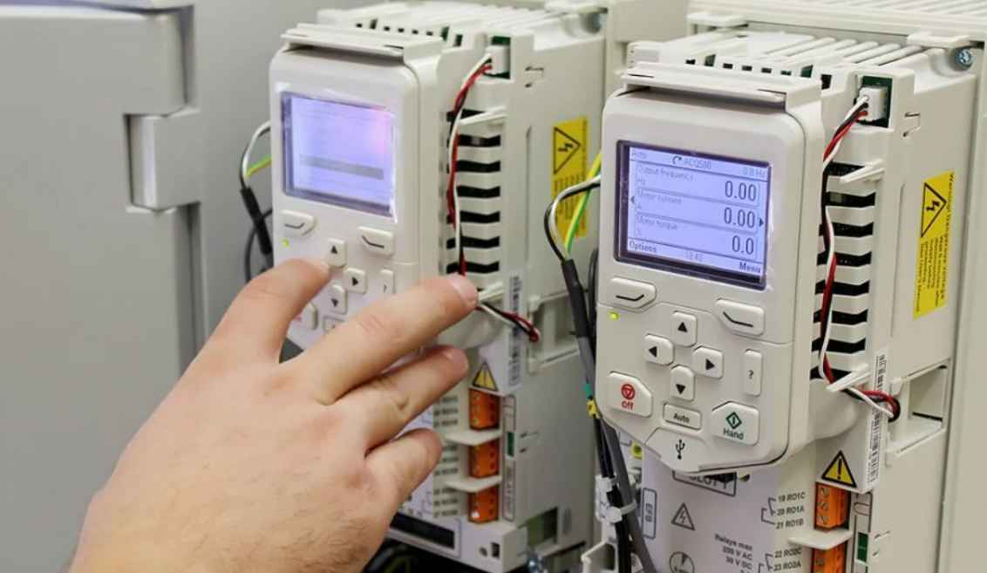
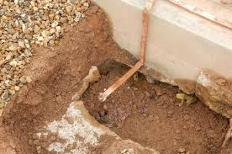
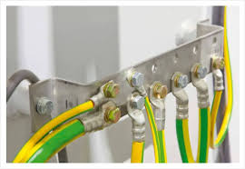
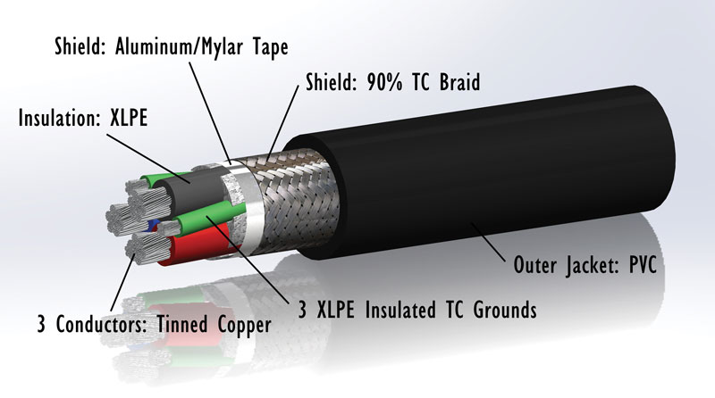
Methods to enhance the Life of VFDs
Proper earthing system.
Dust free environment.
Usage of proper armored/shielded cables.
Proper air conditioning and cooling system.
Strictly Private and confidential
Shakarganj Limited Bhone
4/16

Slide 5
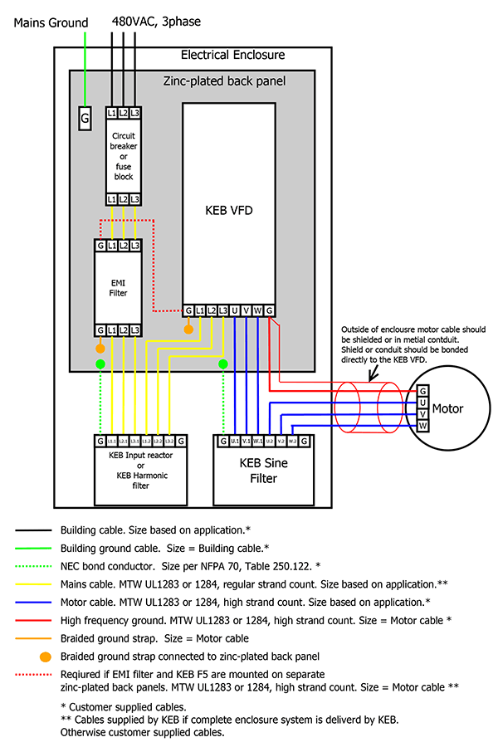
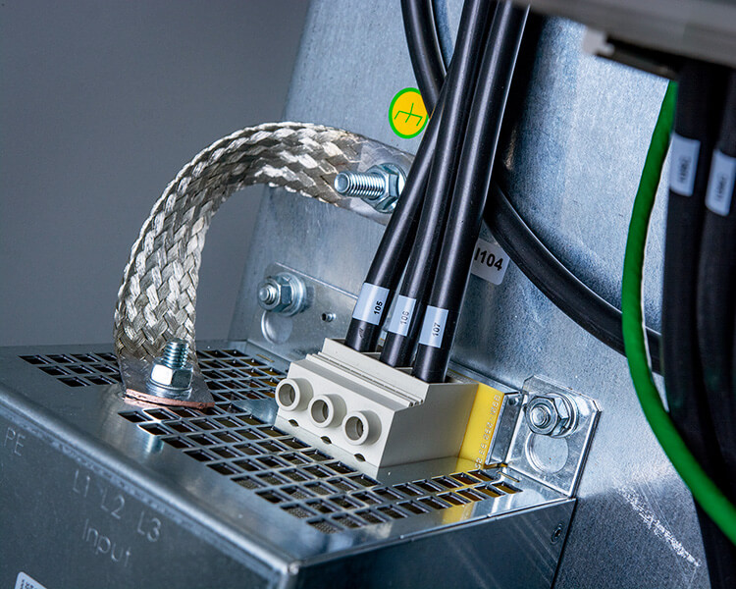
Working Principle of VFD & Need of Earthing
PWM in VFDs results in high speed switching which produces stray currents that must be contained and dissipated by the proper ground system to keep these stray currents from damaging or interfering with system components.
Earthling of VFDs should be carried out independent to the power system to avoid any power surges.
Strictly Private and confidential
Shakarganj Limited Bhone
5/16

Slide 6
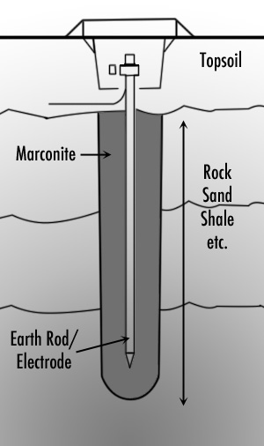
Methods of proper Earthing
Earthing is used to ground fault currents into the earth. For this purpose the ground resistance should be equal to zero. There are several conventional methods of earthing i.e.
Earthing mat/plate
Earthing pipe
Earthing rod
The best and recommended method for earthing is to dig a bore deep until the level of water. Then insert copper rod throughout the bore until it dips into the water. Attach the other end of rod to copper wire of size equal to system neutral and attach this copper wire to earth bus bar of the system.
Strictly Private and confidential
Shakarganj Limited Bhone
6/16

Slide 7
Dust Free Environment
Installation of VFDs in environments with high dust exposure is often unavoidable. Dust deposits on the device surface and inside on circuit boards and electronic components. These deposits act as heat insulation layers and hamper heat transfer to the ambient air, reducing cooling capacity. The components become warmer, causing electronic components to age faster and the unit service life to decrease. Dust deposits on the heat sinks in the back of the unit also decrease service life. Filters are installed on some VFDs which is helpful but it gets clogged over time.
Double door VFD control room and installation of cable glands would be helpful in controlling dust environment.
Strictly Private and confidential
Shakarganj Limited Bhone
7/16

Slide 8
Armored / Shielded cables
Frequency range of VFD can cause issues with normal LV cables, such as signal distortion, noise interference and excessive heat generation. These issues can result in system failure and costly downtime.
Therefore it is crucial to use proper cabling to ensure reliable and efficient operation of motors systems.
Shielded cables are an essential component of VFD systems, as they provide protection against signal distortion, noise interference, and excessive heat generation. When selecting a shielded cable for VFD application it is important to consider factors such as voltage and current signals, cable length, frequency range, EMI/RFI level, shielding type, and environmental conditions.
Strictly Private and confidential
Shakarganj Limited Bhone
8/16

Slide 9
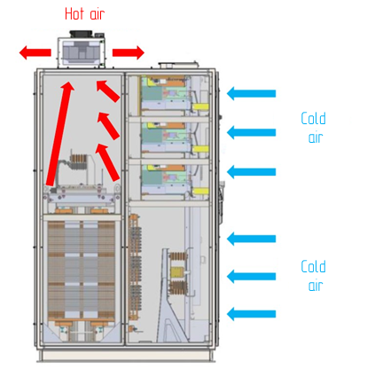
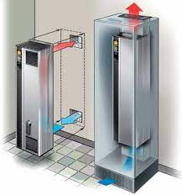
Air Conditioning & Cooling System
During VFD operation, heat is generated inside the enclosure. This heat must be compensated using air conditioners. According to VFD manufacturers, a 10°C increase in temperature over the ambient temperature of 23°C could reduce VFD anticipated life.
The standard temperature for VFDs enclosure should be 23°C.
It must be ensured that cooling air is moisture free.
Strictly Private and confidential
Shakarganj Limited Bhone
9/16

Slide 10
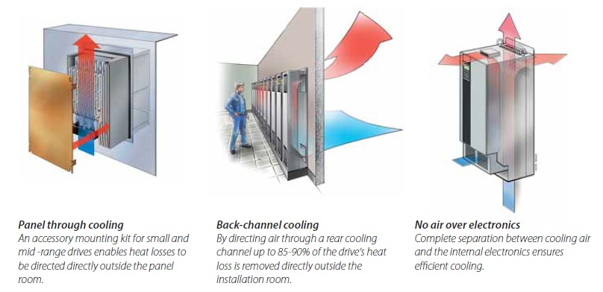
Air Conditioning & Cooling System
10/16

Slide 11
Installation of Air Conditioning
In order to decide how many air conditioning units should be installed in the enclosure a proper method is required. Following factors must be taken in consideration to installed the air conditioning according to the requirement:
Roof Cooling Load:
Floor Cooling Load:
Concrete Wall Cooling Load:
Lighting Cooling Load:
Machines Cooling Load:
Estimated 01 Ton/hr cooling is required for around 30 Sq feet to achieve the proper moisture free and cool environment of VFD room while generally 01 Ton/hr is sufficient for area of 100 Sq feet. Further to reduce the roof cooling load false sealing could be helpful.
Strictly Private and confidential
Shakarganj Limited Bhone
11/16

Slide 12
Definition of Harmonics
In an electric power system, a harmonic of a voltage or current waveform is a sinusoidal wave whose frequency is multiple of the fundamental frequency.
Why are Harmonics Generated:
Harmonic frequencies are produced by the action of non-linear loads such as:
Frequency conversion (variable frequency drives)
SCR or thyristor devices used in various applications for the control or regulation of drives.
An Induction melting furnace is a major source of harmonics generation because it operates on high frequency which affects the waveform of voltage applied. This affects the surrounding electrical equipment.
Strictly Private and confidential
Shakarganj Limited Bhone
12/16

Slide 13
Impact & Control of Harmonics
Impact of Harmonics on Equipment:
Overheating of transformers & motors.
Incorrect operation of electronic instruments, electronic card burning and lighting.
Excessive current in and failure of power factor correcting capacitors
Premature failure of circuit breaker.
How Harmonics can be Controlled:
By using line converters
Active front-end converters
Passive harmonic filters and line reactors at the input
Power inductors
Strictly Private and confidential
Shakarganj Limited Bhone
13/16

Slide 14
Conclusion
Despite of numerous benefits of VFDs to the industry, there are also drawbacks of their usage which need to be compensated through special arrangement and consideration.
Harmonic filters & motor terminators are installed to remove harmonics and resonance.
Signal isolators and shielded cables are used to avoid distortion.
Separate earthing is done for PLC, VFD and Power system to avoid surge currents.
VFDs are sensitive devices that need properly maintained air conditioned, dust & moisture free environment.
Calculated air conditioning should be installed.
Double door arrangement is made to avoid dust entry and cooling loss.
Control rooms are made dust free.
VFDs life could be increased by implementing the above mentioned factors.
Strictly Private and confidential
Shakarganj Limited Bhone
14/16

Slide 15
Questions Please!
Strictly Private and confidential
Shakarganj Limited Bhone
15/16

Slide 16
Strictly Private and confidential
Shakarganj Limited Bhone
16/16

